Slide 1

EXAMINING HORROR MOVIES WITH ADDITONAL GENERS
Using Machine Language and ANOVAs
By Hope McCadden

Slide 2
Summary
What are the characters of additional genres?
What factors impact Review Rating?
What factors impact Movie Rating?

Slide 3
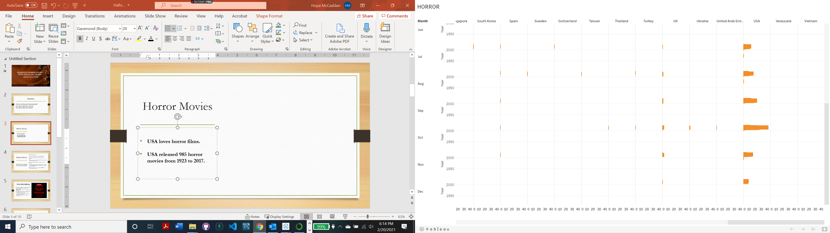
Horror Movies
USA loves horror films.
USA released 985 horror movies from 1923 to 2017.

Slide 4
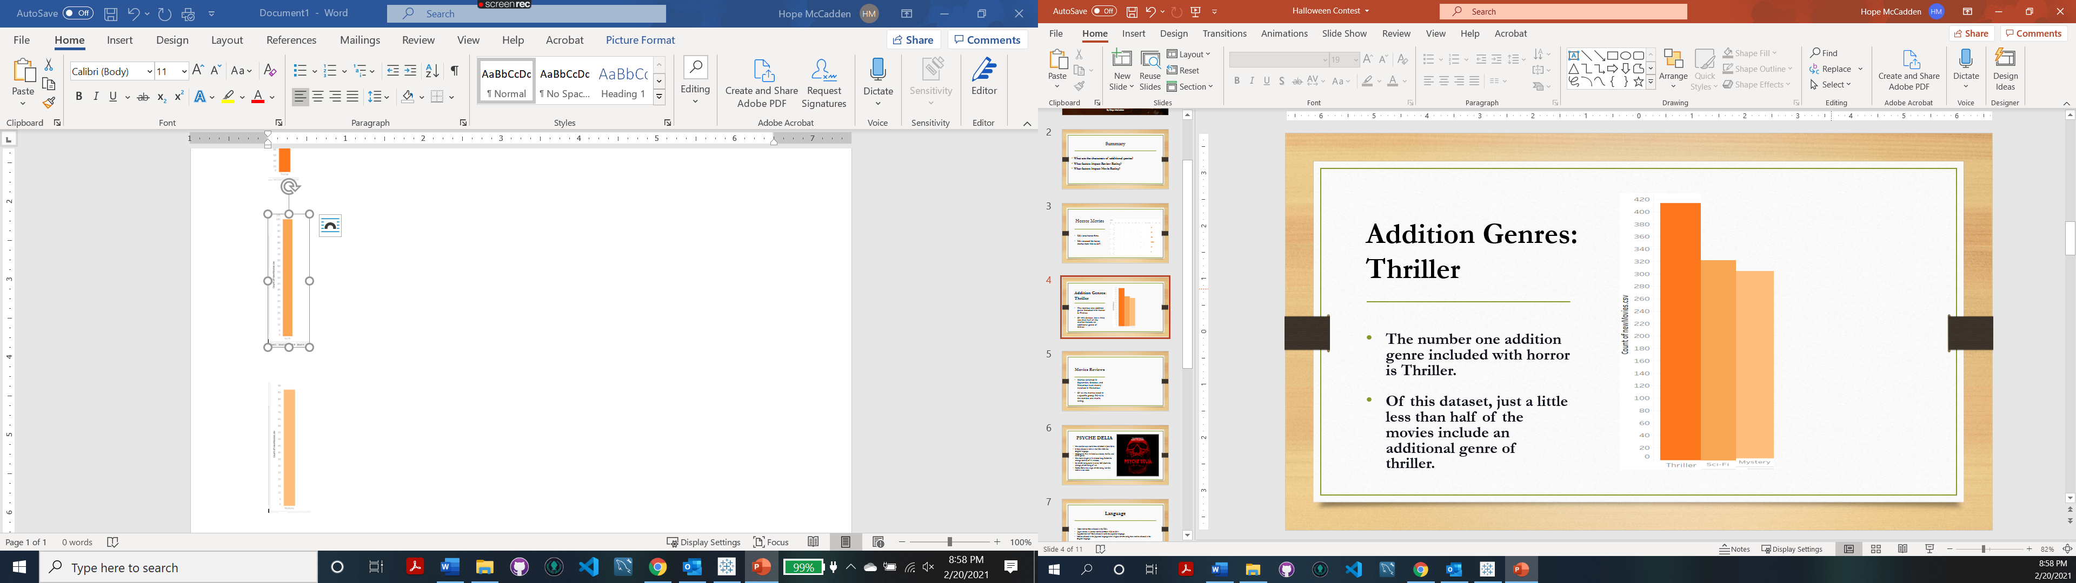
Addition Genres: Thriller
The number one addition genre included with horror is Thriller.
Of this dataset, just a little less than half of the movies include an additional genre of thriller.

Slide 5
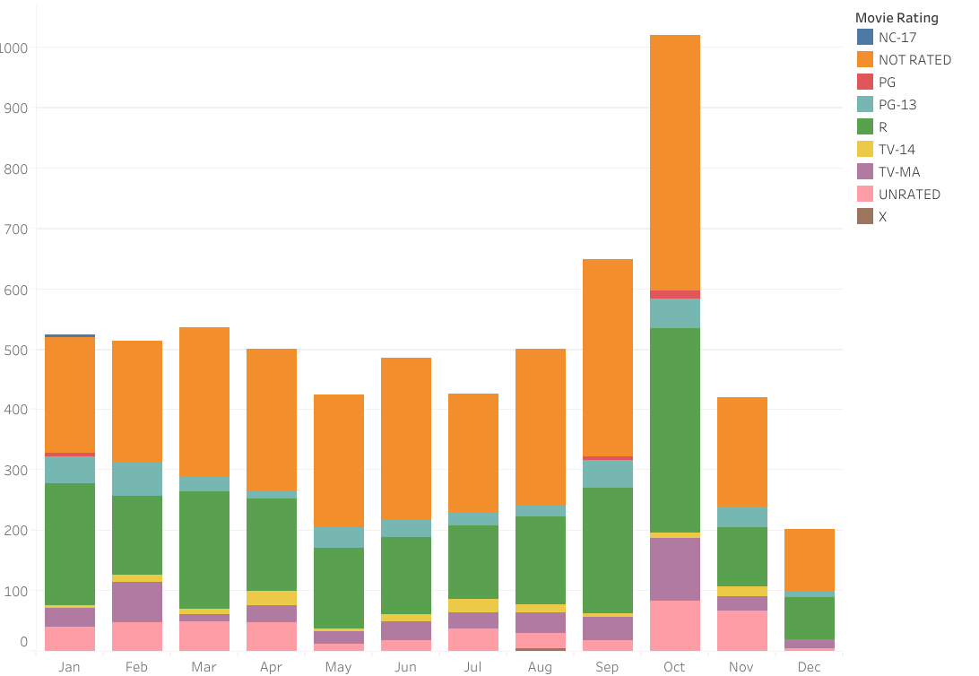
Movies Reviews
Movies reviewed in September, October, and November were mostly watched in October.
Of all the movies rated in a specific group; Rated R is the number one rating.

Slide 6
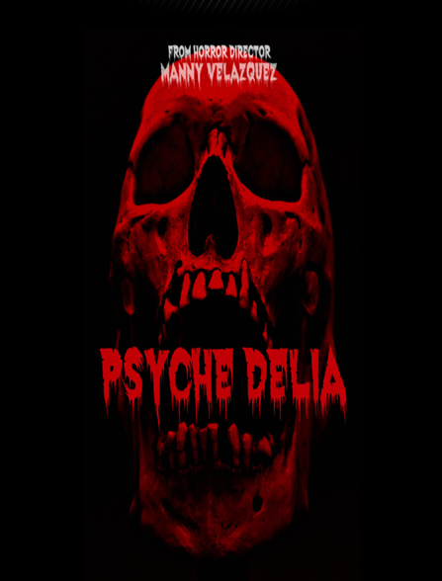
PSYCHE DELIA
The number one movie was reviewed in June 2016.
It was released in 2016 in the USA with the English language.
Multi-genre film; it's listed as a horror, thriller, and Sci-Fi genre.
The movie length is 73 minutes long. Below the average runtime of 91 minutes.
Its review rating came in at 8.6, well above the average review rating of 4.8.
Psyche Delia has a high review rating, but this movie is not rated.

Slide 7

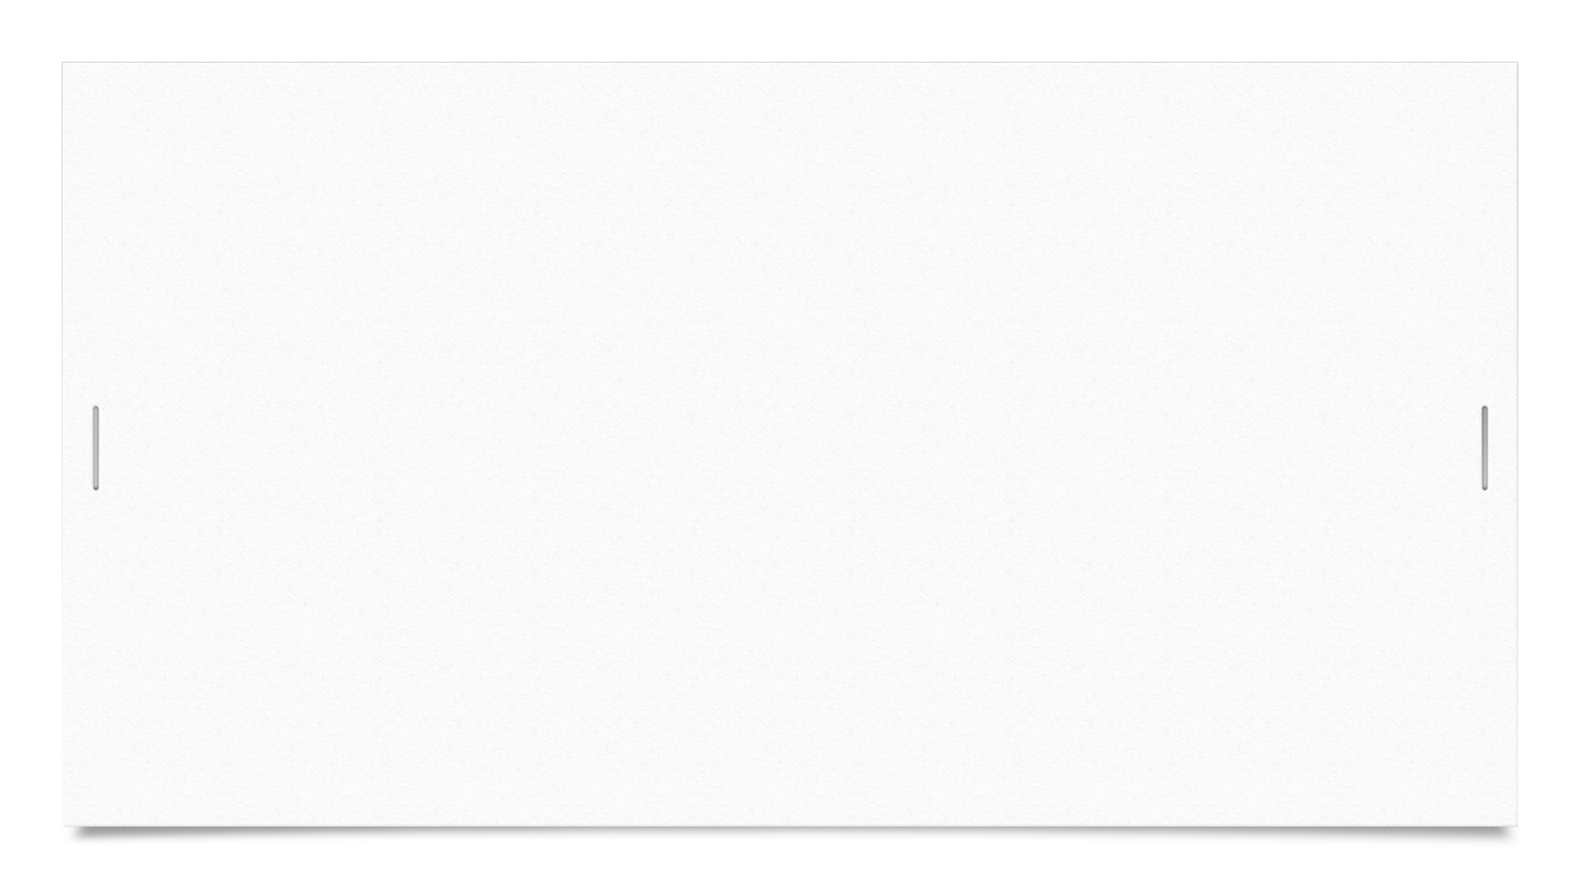
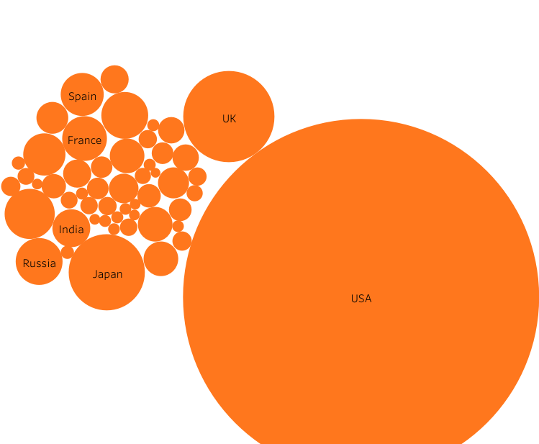

LANGUAGE
Most movies were released in the USA.
Japan release 41 horror movies between 1923 to 2017.
Approximate half were released in only the Japanese language.
Movies released in the Japanese language have a higher review rating than movies released in the English language.

Slide 8
Ratings
According to the data, horror movies reach their peak in 2014, releasing a total of 272 international movies.
Between 2013 to 2015, horror movies released in 2014 had a 13% increase in the review rating than in 2013 and 2015.
After 2014 it appears that the desire to release horror movies had declined greatly.
197-horror movie was released in 2017, but the review rating for 2017 increased by 37% from 2014.

Slide 9
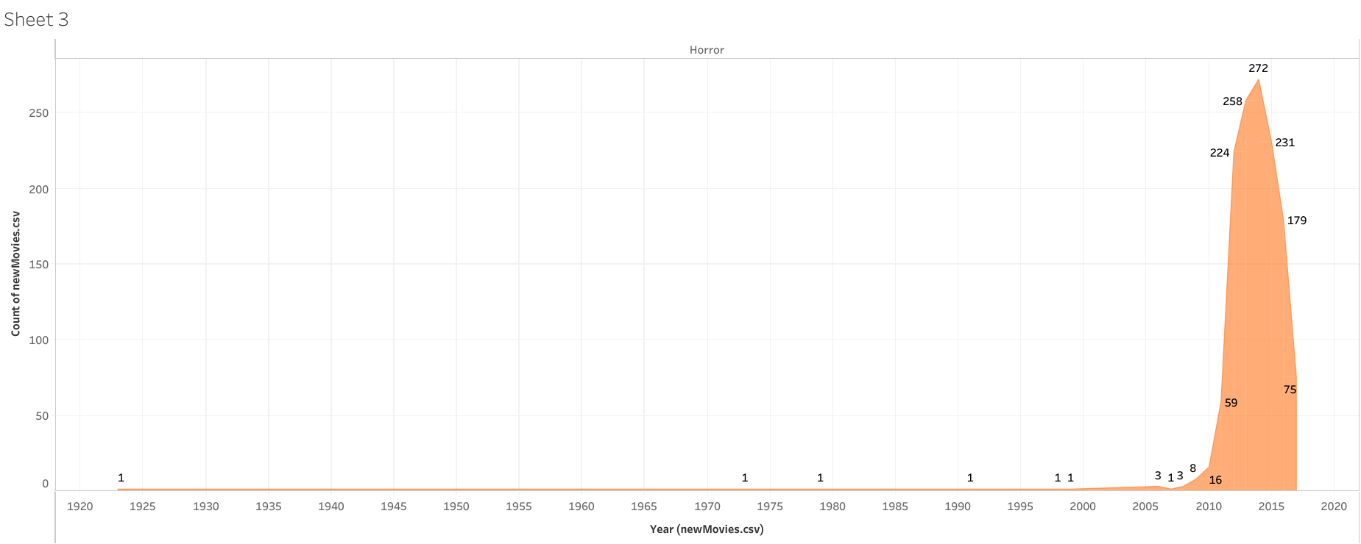
Horror Movies Ratings
Reached its peak in 2014, released 272 international movies.
In 2014, 13% increase in the review rating than in 2013 and 2015.
After 2014 it appears that the desire to release horror movies had declined greatly.
197-horror movie was released in 2017, but the review rating for 2017 increased by 37% from 2014.

Slide 10
Genres
This dataset contains 15 genres.
The top 3 genres are Thriller, Sci-Fi, and Mystery.
Movies with multiple genres, Thriller is the additional genre.
Horror movies that have a review rating have Mystery as the additional genre.
There is a 48 % difference in the review rating for Horror movies that include Mystery than horror movies that have the Thriller genre.
Movies with genres of Horror and Mystery have a 41% difference in the review rating than Horror movies with Sci-Fi genres.

Slide 11
CONCLUSION

Slide 12
QUESTIONS

